Slide 1
PINN

Slide 2

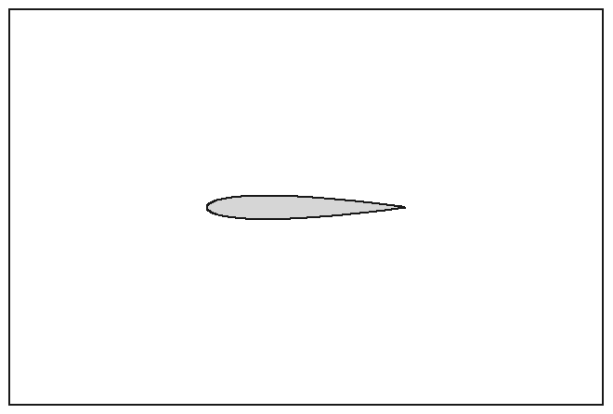
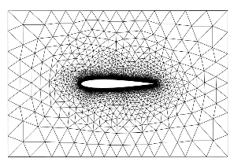


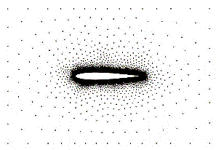
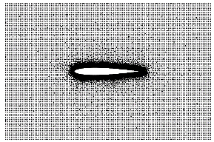
Proposed workflow
Third party
1) Generate geometry
Potential interface with other packages
Major hypothesis tested:
From geometry to collocation points: use engineering software (FreeCAD) and get baseline mesh, which defines problem through annotation. Densification can be applied if needed.
Split domain with specialized loss functions (equilibrium, initial condition, boundary conditions).
DDP implementation and deployment
Parametric modeling
Bulk of parallelization
Finished
2. Annotate equilibrium, BC, and material and generate baseline mesh
Almost finished
Current work
from mesh
densified
3) Generate file with collocation points
4) Customize (template) Python code for equilibrium, BC, and material
5) Generate solver setup files
6) Run solver

Slide 3
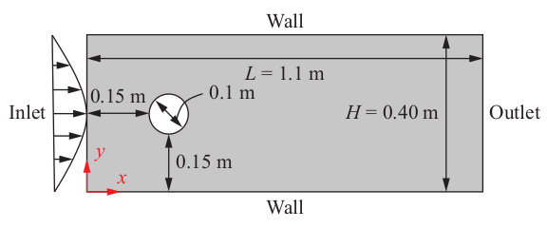
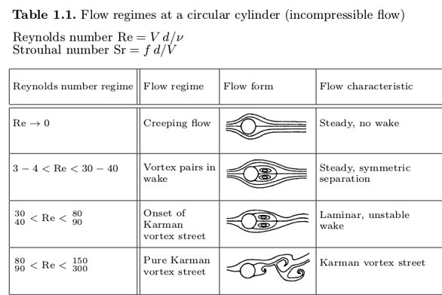
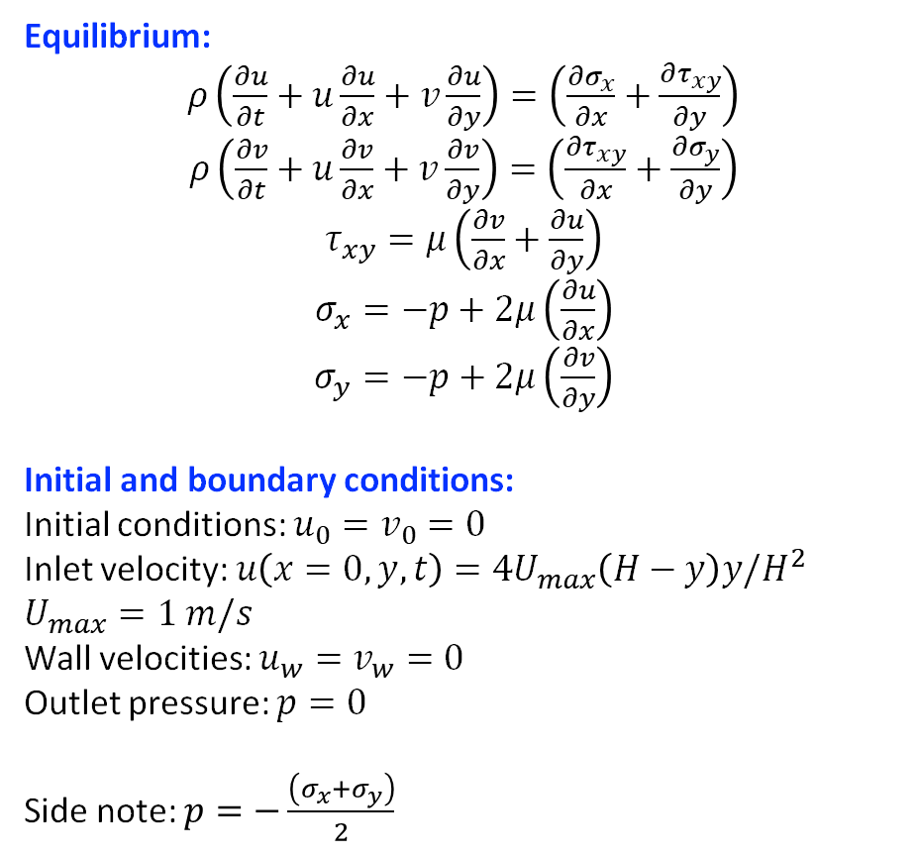
Recap: Navier-Stokes in the stress tensor (ST) form
Equilibrium:
$ρ\left(\frac{∂u}{∂t}+u\frac{∂u}{∂x}+v\frac{∂u}{∂y}\right)=\left(\frac{∂σ_{x}}{∂x}+\frac{∂τ_{xy}}{∂y}\right)$
$ρ\left(\frac{∂v}{∂t}+u\frac{∂v}{∂x}+v\frac{∂v}{∂y}\right)=\left(\frac{∂τ_{xy}}{∂x}+\frac{∂σ_{y}}{∂y}\right)$
$τ_{xy}=μ\left(\frac{∂v}{∂x}+\frac{∂u}{∂y}\right)$
$σ_{x}=−p+2μ\left(\frac{∂u}{∂x}\right)$
$σ_{y}=−p+2μ\left(\frac{∂v}{∂y}\right)$
Initial and boundary conditions:
Initial conditions: $u_{0}=v_{0}=0$
Inlet velocity: $u\left(x=0,y,t\right)=4U_{max}\left(H−y\right)y/H^{2}$
$U_{max}=1 m/s$
Wall velocities: $u_{w}=v_{w}=0$
Outlet pressure: $p=0$
Side note: $p=−\frac{\left(σ_{x}+σ_{y}\right)}{2}$

Slide 6
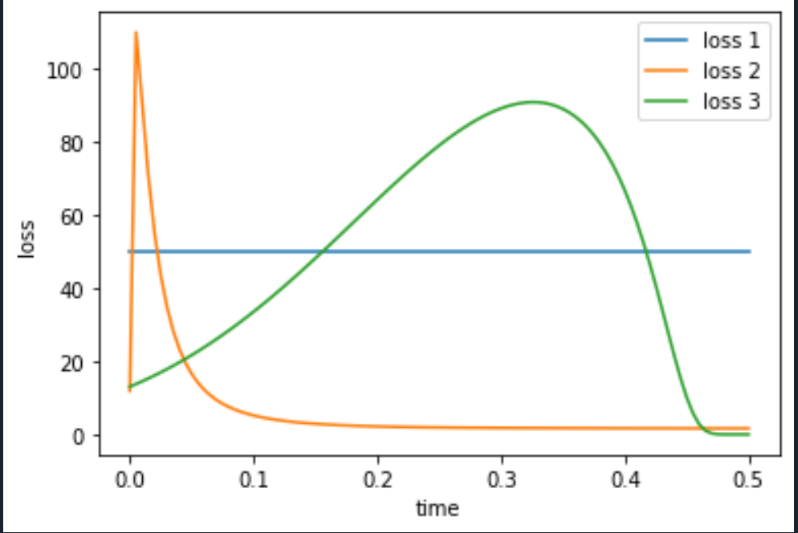
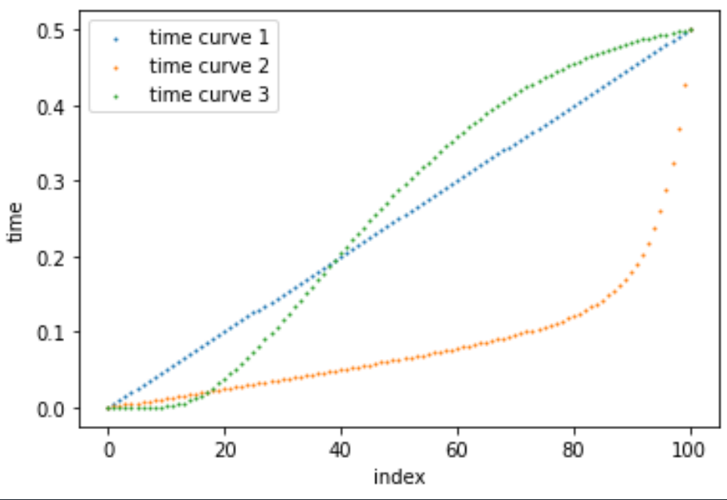
Dynamic time discretization
Address error in the time dimension (transient) dynamically during training

Slide 7
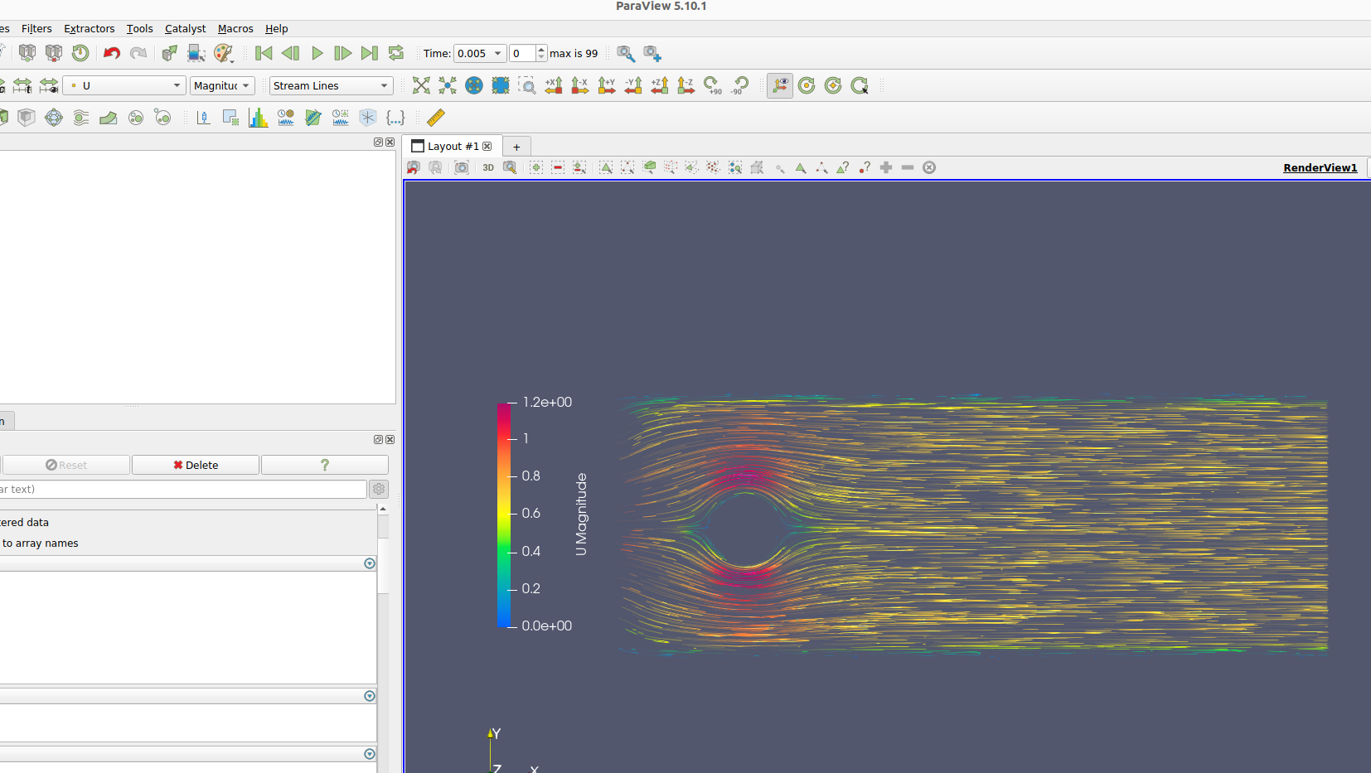
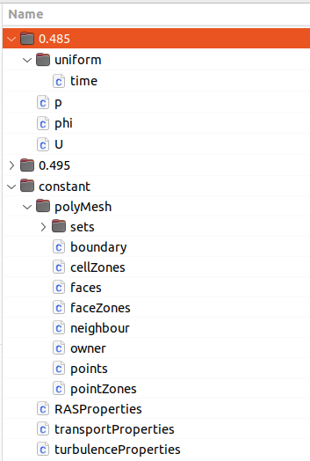
Sycamore: post-processing routines (work in progress)

Slide 8
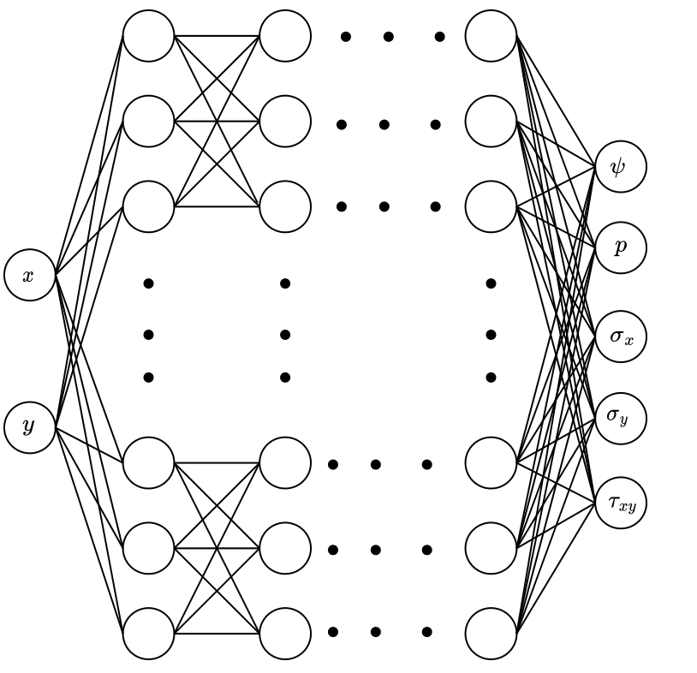
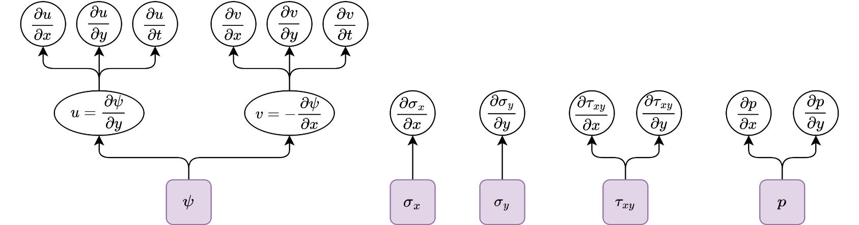
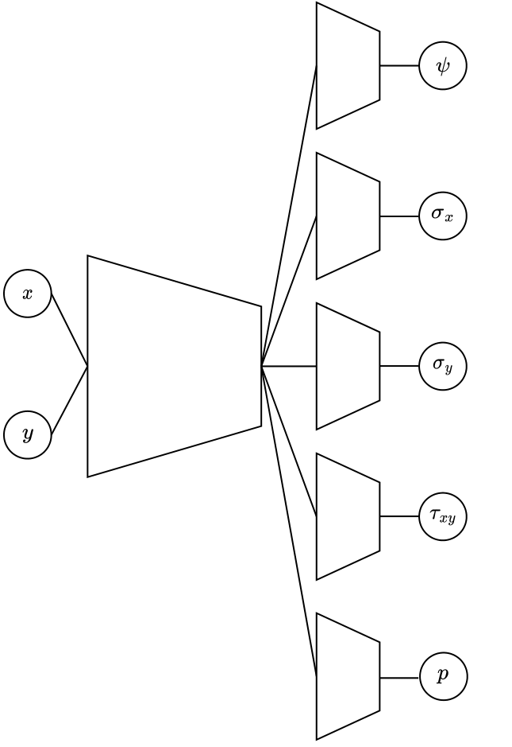
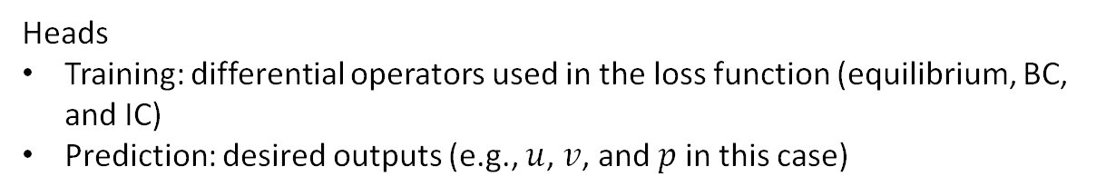
PINN and training/prediction heads
(a) PINN
(b) Training and prediction heads
Heads
Training: differential operators used in the loss function (equilibrium, BC, and IC)
Prediction: desired outputs (e.g., $u$, $v$, and $p$ in this case)

Slide 9
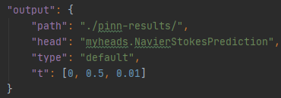
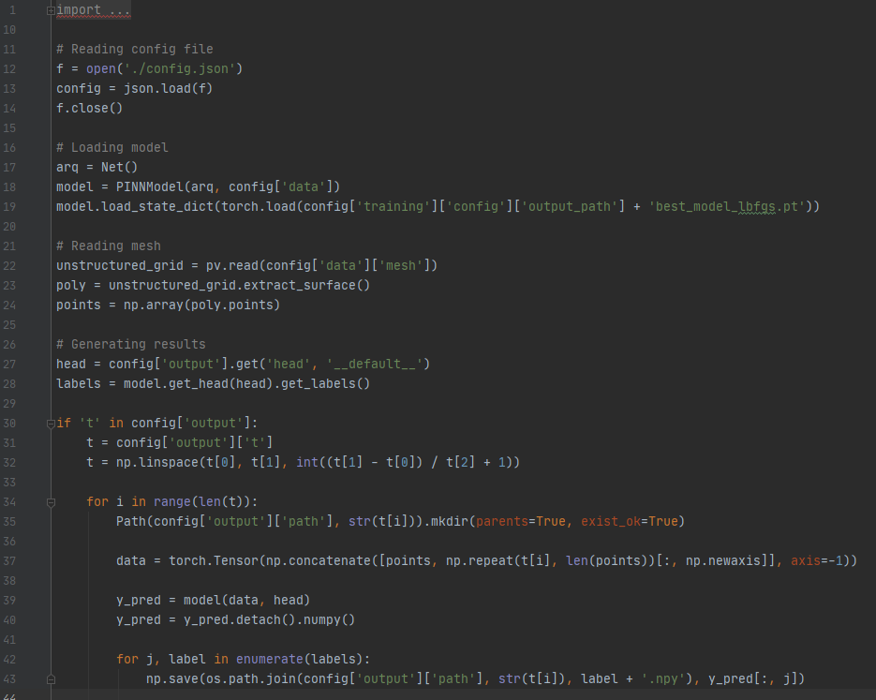
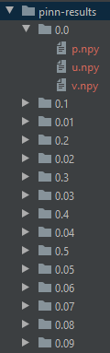
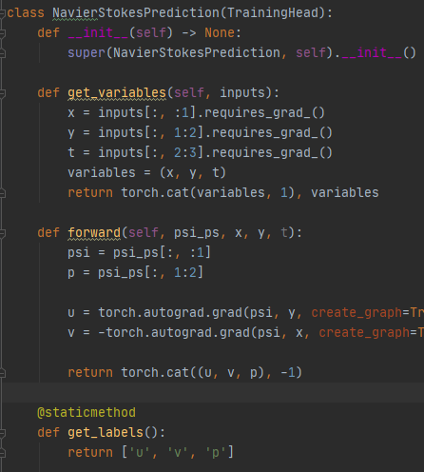
Intermediate results files
(a) config.json + prediction head
(b) postprocessing.py
(c) Project folder

Slide 10

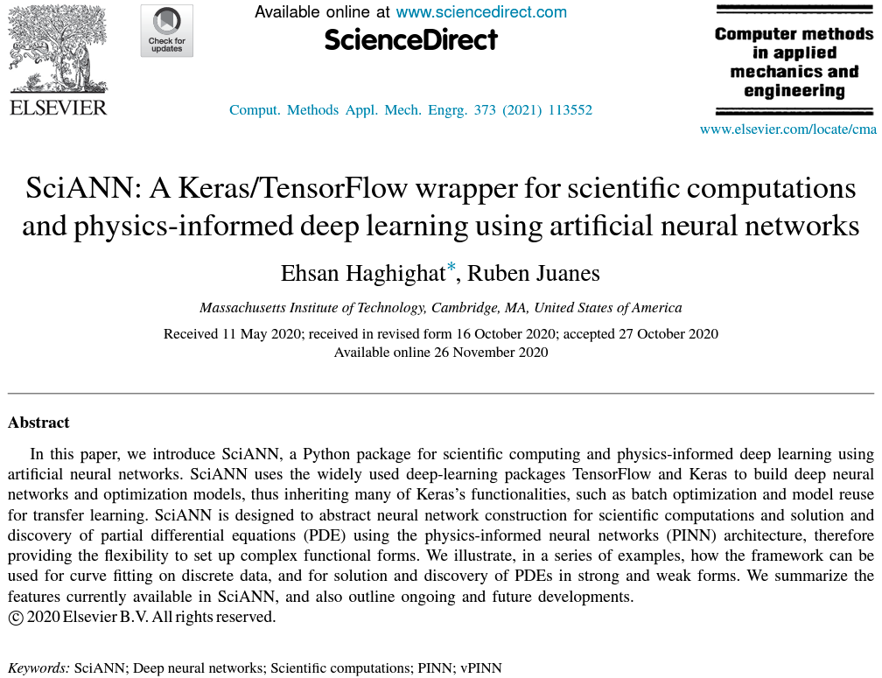
Suggestion for dissemination/publication
144 citations according to GoogleScholar

Slide 12


Migration from Accelerate to Lightning
Accelerate
Thin wrapper for distributed environments
Pros:
Enables PyTorch code to run across multiple distributed configuration
Easy to integrate (minimal code changes)
Cons:
Supports only CPUs, GPUs, and TPUs
Requires a CLI
Lightning
Complete research framework
Pros:
Models become hardware agnostic
Runs distributed training
Engineering code is abstracted away
Handles logging, metrics, and other non-essential research code
Supports CPUs, GPUs, TPUs, IPUs, and HPUs
Cons:
Implementation of custom training loops requires more work than Accelerate

Slide 13
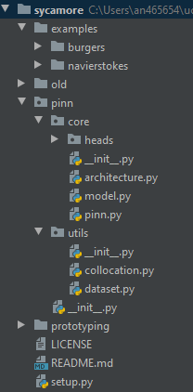
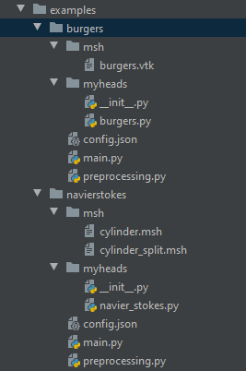
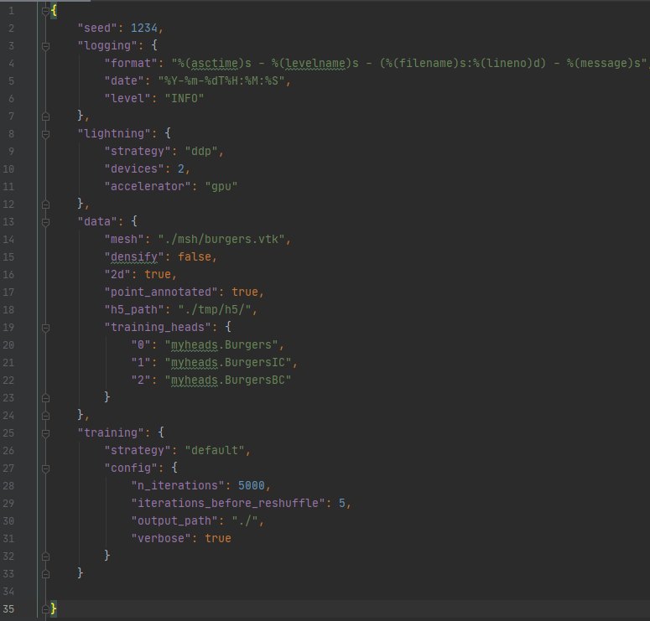
Sycamore: GitHub repo
(a) Repo structure
(b) config.json

Slide 14
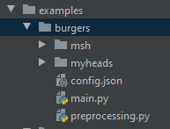
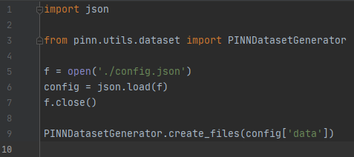
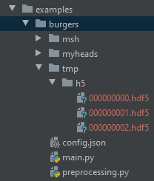
Sycamore: preprocessing routine
(a) Example available in the GitHub repo
Observations:
can be used/modified by user if needed or (later on) turned into a CLI command
can group collocation points using a second coarser reference mesh
(b) Using preprocessing.py

Slide 15
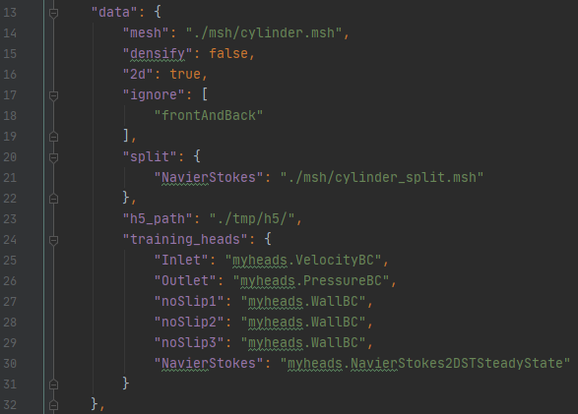
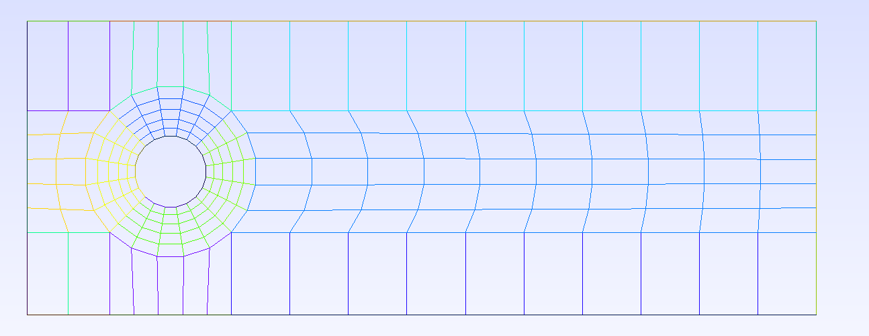
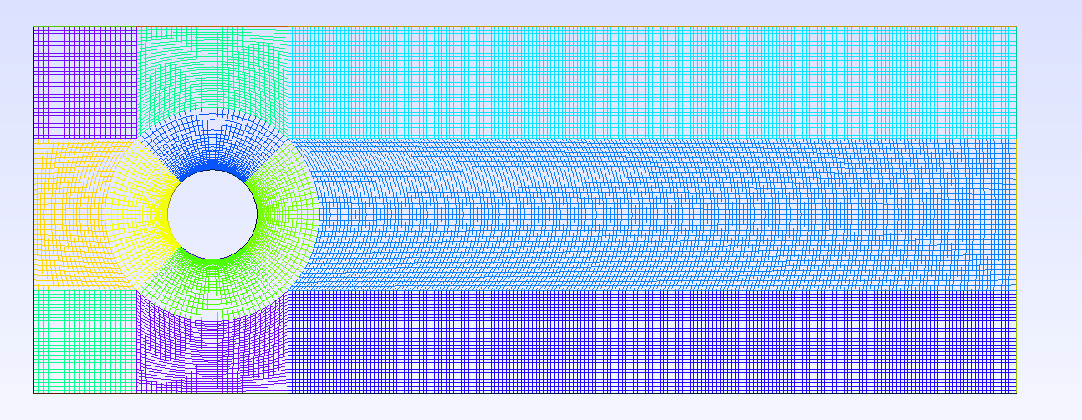
Sycamore: using coarser reference mesh
(a) config.json
(b) cylinder_split.msh
(c) cylinder.msh

Slide 16
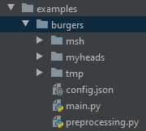
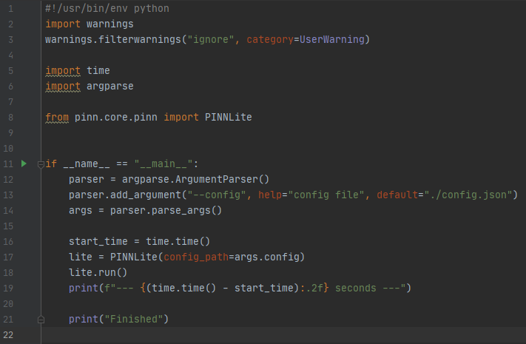
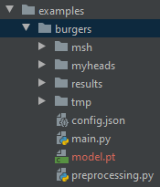
Sycamore: running solver
What we already save:
Model weights
Work in progress:
Checkpoints
Performance metrics
Logs
Predictions
Hooks
etc…

Slide 17
Sycamore: post-processing routines (work in progress)

Slide 18
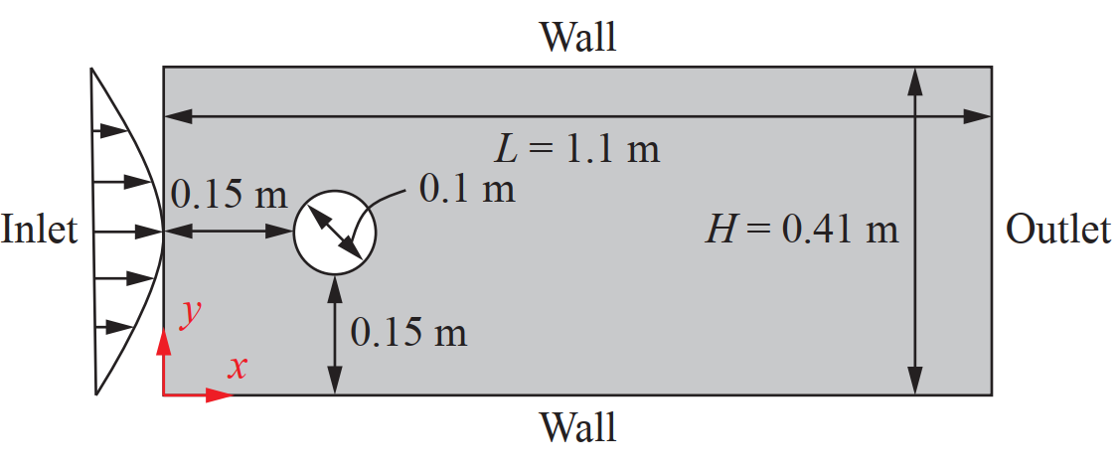
Recap: Navier-Stokes in the stress tensor (ST) form
Equilibrium:
$ρ\left(\frac{∂u}{∂t}+u\frac{∂u}{∂x}+v\frac{∂u}{∂y}\right)=\left(\frac{∂σ_{x}}{∂x}+\frac{∂τ_{xy}}{∂y}\right)$
$ρ\left(\frac{∂v}{∂t}+u\frac{∂v}{∂x}+v\frac{∂v}{∂y}\right)=\left(\frac{∂τ_{xy}}{∂x}+\frac{∂σ_{y}}{∂y}\right)$
$τ_{xy}=μ\left(\frac{∂v}{∂x}+\frac{∂u}{∂y}\right)$
$σ_{x}=−p+2μ\left(\frac{∂u}{∂x}\right)$
$σ_{y}=−p+2μ\left(\frac{∂v}{∂y}\right)$
Initial and boundary conditions:
Initial conditions: $u_{0}=v_{0}=0$
Inlet velocity: $u\left(x=0,y,t\right)=4U_{max}\left(H−y\right)y/H^{2}$
$U_{max}=1 m/s$
Wall velocities: $u_{w}=v_{w}=0$
Outlet pressure: $p=0$
Side note: $p=−\frac{\left(σ_{x}+σ_{y}\right)}{2}$

Slide 19
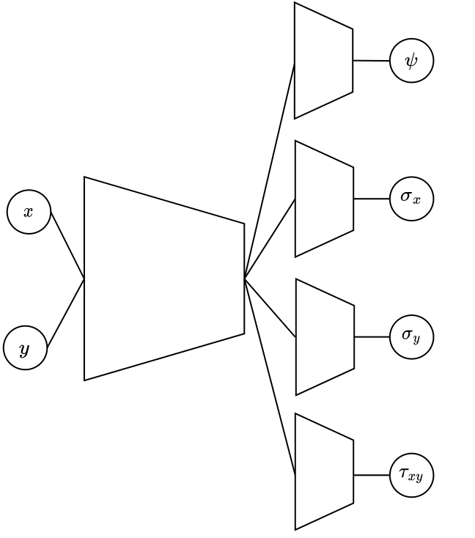
MLP architectures
(a) Simple fully connected
8 hidden layers (40 neurons each)
5 neuron output layer
13,445 trainable parameters
(b) MLP with 5 heads:
Shared encoder:
4 layers: 64 / 64 / 32 / 32
Individual encoders:
6 Layers: 32 / 16/ 8 / 4 / 4 / 1
12,529 trainable parameters
(c) MLP with 4 heads:
Shared encoder:
4 layers: 32 / 32 / 16 / 8
Individual encoders:
6 Layers: 8 / 4/ 4 / 2 / 2 / 1
2,756 trainable parameters
We now follow the exact same architecture from Rao et al. (2020) as opposed to a smaller MLP based on other papers.

Slide 21
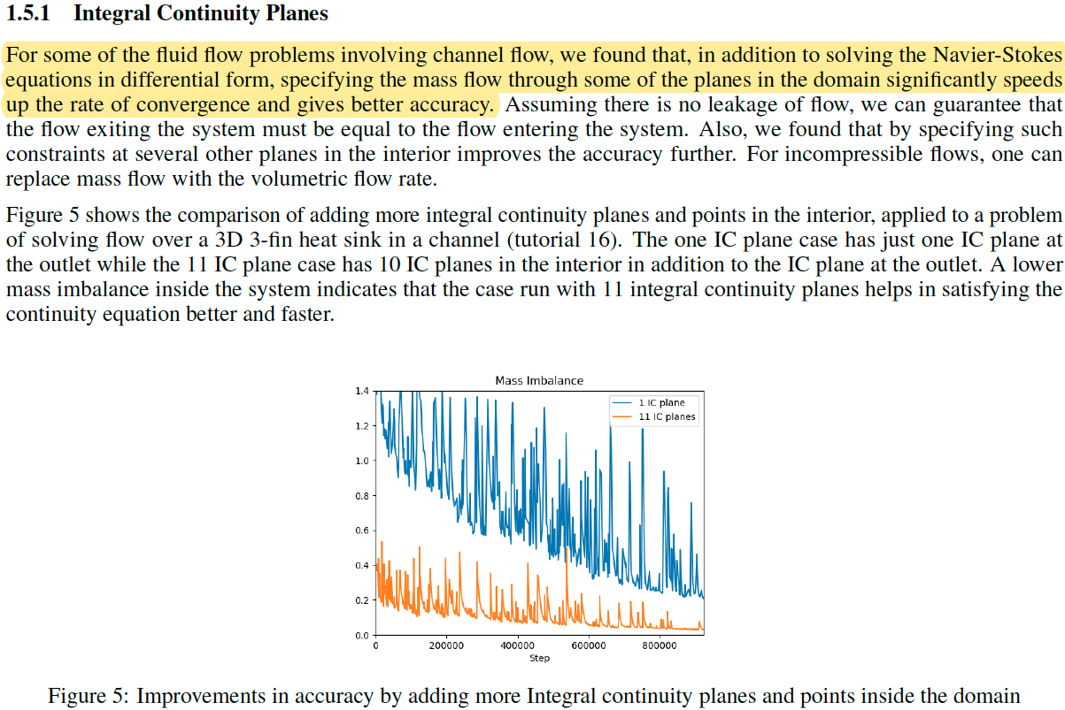
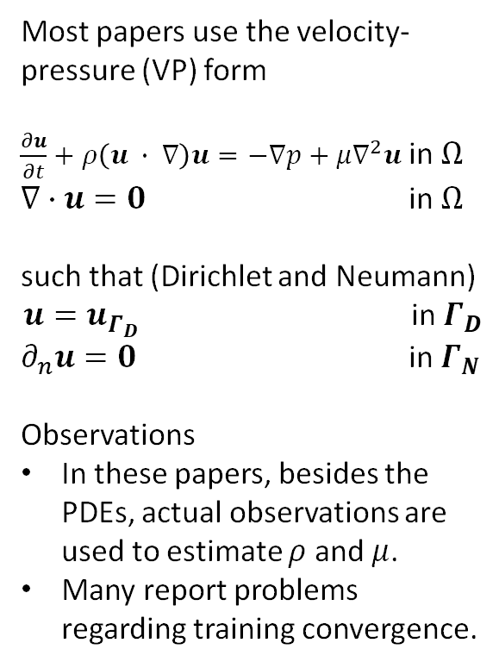
Navier-Stokes in the velocity-pressure (VP) form
(a) Approach to improve solution from Modulus (SimNet)
Most papers use the velocity-pressure (VP) form
$\frac{∂u}{∂t}+ρ\left(u ∙ ∇\right)u=−∇p+μ∇^{2}u$ in $Ω$
$∇∙u=0$ in $Ω$
such that (Dirichlet and Neumann)
$u=u_{Γ_{D}}$ in $Γ_{D}$
$∂_{n}u=0$ in $Γ_{N}$
Observations
In these papers, besides the PDEs, actual observations are used to estimate $ρ$ and $μ$.
Many report problems regarding training convergence.

Slide 22
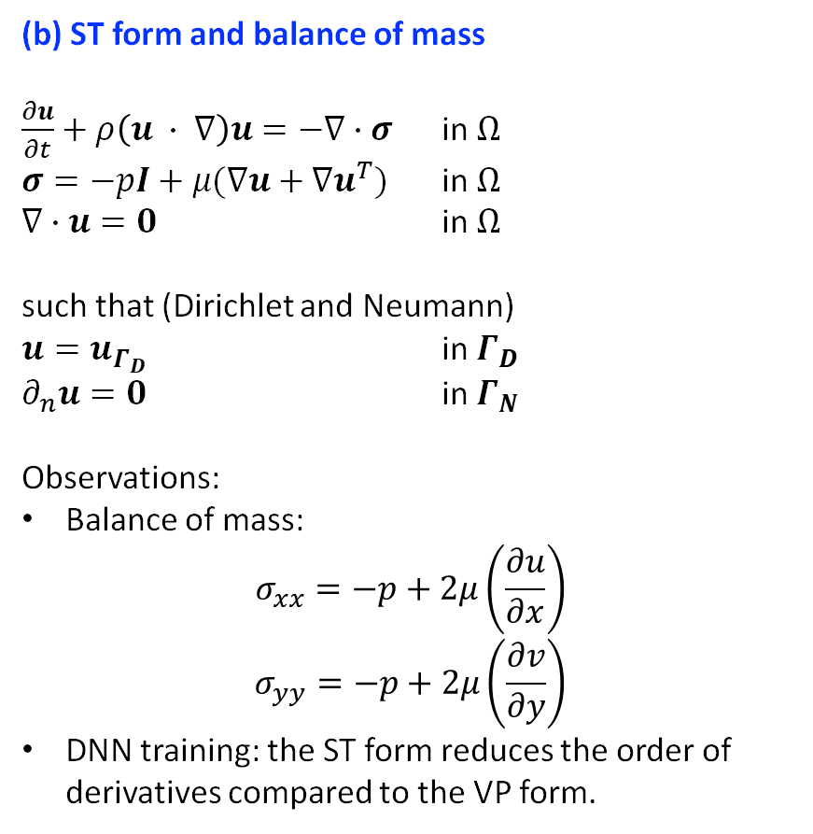
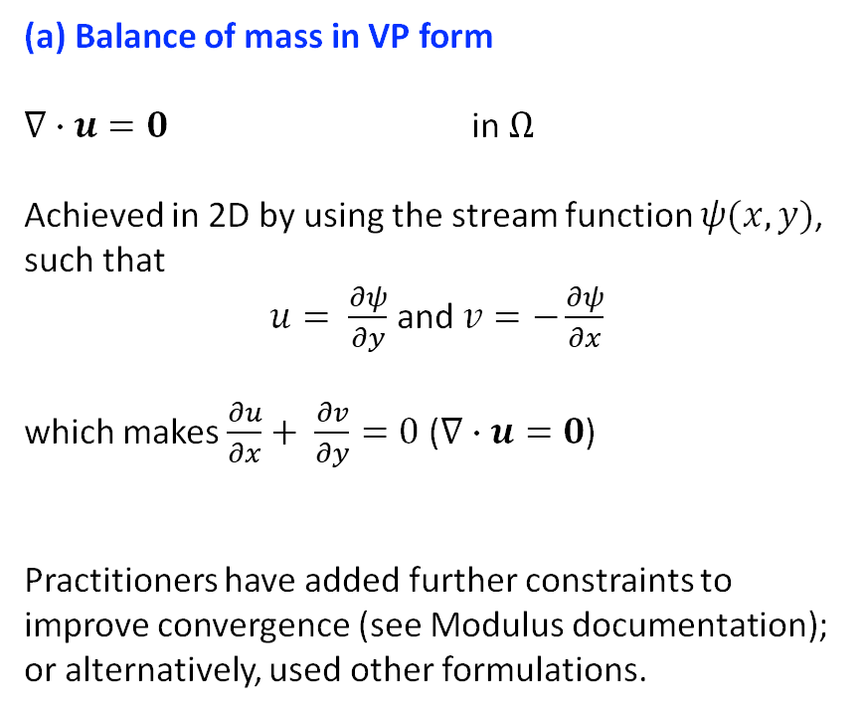
Navier-Stokes in the stress tensor (ST) form
(a) Balance of mass in VP form
$∇∙u=0$ in $Ω$
Achieved in 2D by using the stream function $ψ(x,y)$, such that
$u= \frac{∂ψ}{∂y}$ and $v=−\frac{∂ψ}{∂x}$
which makes $\frac{∂u}{∂x}+ \frac{∂v}{∂y}=0$ ($∇∙u=0$)
Practitioners have added further constraints to improve convergence (see Modulus documentation); or alternatively, used other formulations.
(b) ST form and balance of mass
$\frac{∂u}{∂t}+ρ\left(u ∙ ∇\right)u=−∇∙σ$ in $Ω$
$σ=−pI+μ(∇u+∇u^{T})$ in $Ω$
$∇∙u=0$ in $Ω$
such that (Dirichlet and Neumann)
$u=u_{Γ_{D}}$ in $Γ_{D}$
$∂_{n}u=0$ in $Γ_{N}$
Observations:
Balance of mass:
$$σ_{xx}=−p+2μ\left(\frac{∂u}{∂x}\right)$$
$$σ_{yy}=−p+2μ\left(\frac{∂v}{∂y}\right)$$
DNN training: the ST form reduces the order of derivatives compared to the VP form.

Slide 23
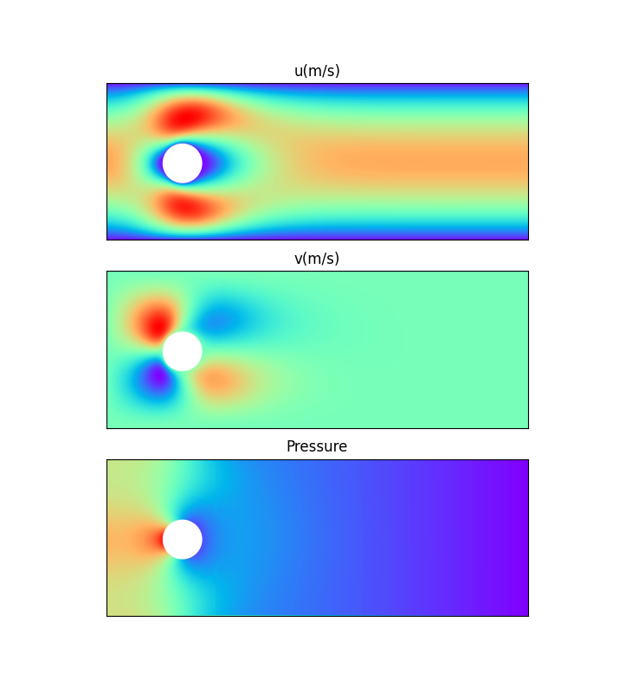
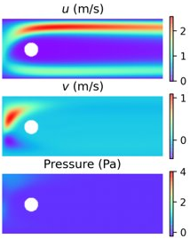
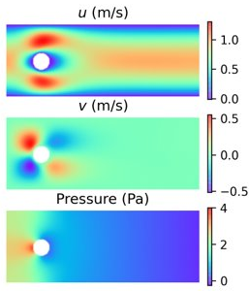
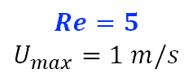
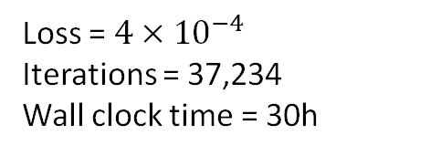

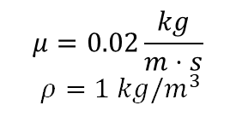
Laminar and steady state (explicitly making $\frac{∂u}{∂t}=0)$
(a) OpenFOAM
(b) VP formulation*
(c) ST formulation**
$$μ=0.02\frac{kg}{m⋅s}$$
$$ρ=1 kg/m^{3}$$
Loss = 5.54$×{10}^{−5}$
Iterations = 24,000
Wall clock time = 19h
Loss = $4×{10}^{−4}$
Iterations = 37,234
Wall clock time = 30h
$$Re=5$$
$$U_{max}=1 m/s$$
*Using our PyTorch implementation
**Using a TF1 implementation from Rao et al. (2020) (our implementation works the same)

Slide 24
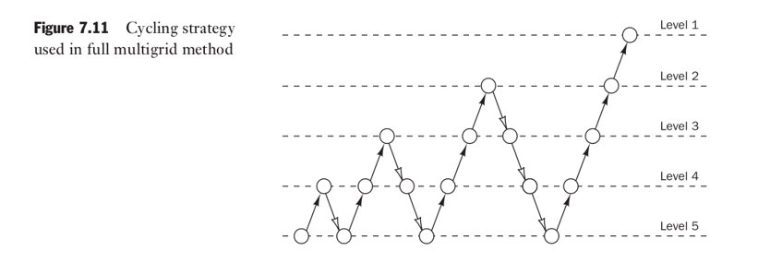
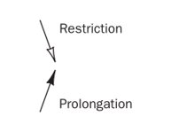

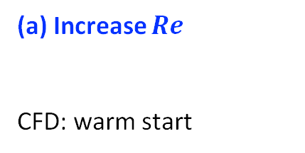
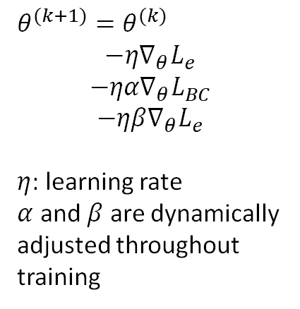
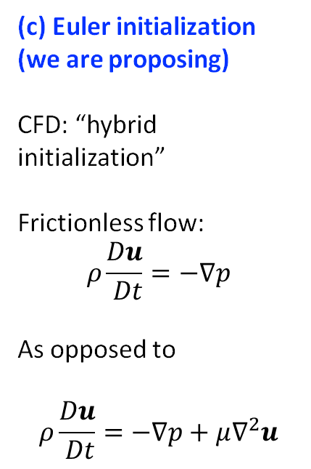
Improving PINN optimization
Literature has recognized need for specialized training schemes
(a) Increase $Re$
CFD: warm start
(b) Adaptive learning rate
CFD: --
(c) Euler initialization (we are proposing)
CFD: “hybrid initialization”
Frictionless flow:
$$ρ\frac{Du}{ Dt}=−∇p$$
As opposed to
$$ρ\frac{Du}{ Dt}=−∇p+μ∇^{2}u$$
(d) Vary collocation point density
CFD: multigrid
$$Re$$
$θ^{(k+1)}=θ^{(k)}$
$$−η∇_{θ}L_{e}$$
$$−ηα∇_{θ}L_{BC}$$
$$−ηβ∇_{θ}L_{e}$$
$η$: learning rate
$α$ and $β$ are dynamically adjusted throughout training
Level 1
Regular training
Warm start
Level 5
Iterations
https://proceedings.neurips.cc/paper/2021/file/df438e5206f31600e6ae4af72f2725f1-Paper.pdf
https://www.sciencedirect.com/science/article/pii/S0021999120307257
Versteeg, H. K., Malalasekera, W. (2007). An Introduction to Computational Fluid Dynamics: The Finite Volume Method.

Slide 25







If mass balance continues to be a problem
Conservation principle:
Mass flow going into the element is equal to mass flow going out of the element
At the element level:
$$\sum{a_{i} n_{i} ∙ u_{i}}=0$$
Integrate the domain and add a mass flow conservation component to the loss:
$$L=\sum_{j}{{\left(\sum{a_{i} n_{i} ∙ u_{i}}\right)}^{2}}$$
Observations:
Eliminate heuristic regarding “conservation planes”
Replace element nodes with edge/face centroid
2D and 3D formulations are the same
$$u_{i}$$
$$n_{i}$$
$$a_{i}$$
Legend
Element
Node (collocation point)
$u_{i}$, velocity
$n_{i}$, normal to the element edge/face
$a_{i}$, length/area of the element edge/face

Slide 27


Tracking gradients
http://proceedings.mlr.press/v9/glorot10a/glorot10a.pdf
https://epubs.siam.org/doi/pdf/10.1137/20M1318043

Slide 28

Architecture
https://epubs.siam.org/doi/pdf/10.1137/20M1318043

Slide 29

Dealing with time (beg, borrow, steal?)
https://proceedings.neurips.cc/paper/2021/file/df438e5206f31600e6ae4af72f2725f1-Paper.pdf

